Slide 1

Improving your scientific writing skills
Charitha Pattiaratchi
School of Engineering and The UWA Oceans Institute
The University of Western Australia

Slide 2


Slide 3


Slide 4


Slide 5
Origins of Scientific Writing
Knowledge is lost without written records
Cave paintings and inscriptions were the first attempts to leave records
About 2000 BC, Papyrus paper was used as a medium of communication
In 190 BC, parchment made from animal skin came into use
In 105 AD, the Chinese invented paper
Knowledge could not be widely circulated with no effective duplication
In 1100 AD, the Chinese invented movable type
In 1455 AD, Gutenberg printed his 42-line Bible from movable type on a printing press
By the year 1500 thousands of copies of hundreds of books (called “incunabula”) were printed
In 1665, the first scientific journals were published

Slide 6
Why the concern with writing?
Poor writing and cloudy thinking go hand in hand
You will be judged by the scientific community largely on your writing
You get a PhD !!!
Scientists receive little formal training in writing, and it is difficult to write well without training
Employers look for communication skills
Graduate students commonly have writing problems, irrespective of mother tongue
Fortunately, good technical writing is somewhat formulaic

Slide 7
Some important Language points:
Poor experimentation cannot be masked by brilliant writing; however, poor writing can mask brilliant experimentation
Avoid complex sentence structure. Use simple and clear English
Always keep in mind that the paragraph is the essential unit of thought

Slide 8
Some important Language points
Though most people can write reasonable sentences, a surprising number have difficulty organizing sentences into effective paragraphs.
A paragraph should begin with a topic sentence that sets the stage clearly for what will follow. Make topic sentences short and direct.
Build the paragraph from the ideas introduced in your topic sentence and make the flow of individual sentences follow a logical sequence. One idea per paragraph.

Slide 9
Some important Language points:
Pay attention to tenses.
Problems of inappropriate or inconsistent tenses are common in writing. What you, or others, did in the past should be stated in the past tense (e.g. data were collected...."). Events or objects that continue to happen or exist can be described in the present tense (e.g., "in this paper, I examine....... The data reject the hypothesis that......). Whatever tense you choose, be consistent.
Be careful in using "might," "may," and "would" (as in "this might indicate that..."). They are frequently used as ways of out of making a clear statement.

Slide 10
Example
Figure 3b reveals that, resuspension occurs below the critical velocity range where the mean current velocity is 0.15 m/s which was less than the threshold velocity U_{cr}=0.16 m/s. Below the 5 (dB) backscatter reading, among the five high resuspension events three occurred during burst and two during sweep suggesting high resuspension events are associated with bursts. Therefore, it can be seen that the both above and below the critical velocity range, resespension events are burst dominated.
Resuspension events occurred below the critical velocity range where the mean current velocity was 0.15 m/s, that was less than the threshold velocity U_{cr}=0.16 m/s (Figure 3b). Below the 5 (dB) backscatter level, the five highest resuspension events, three occurred during bursts and two during sweeps suggesting high resuspension events were associated with bursts. Therefore, both above and below the critical velocity range, resespension events were dominated by bursts.

Slide 11
Advice for writing a paper
A paper is a scientific story with a clear single message
Draft your objectives (message you want convey)
Prepare your figures and place them in sequence to make sure that you have sufficient material to convey the message
Prepare simple declarative statements that highlight the key results
Ensure your objectives have been addressed
You are now ready to write the paper

Slide 12
Paper writing process
Complete the work required for the paper
Complete first draft and undertake internal review (co-authors, supervisor, colleagues)
Submit to Journal
Editor sends it out to reviewers
Editor makes decision based on recommendation of reviewers usually requires modification (minor or major) or rejection.
Address the reviewers comments clearly and document the changes and then re-submit to Editor.
No difference to PhD

Slide 13
IMRAD Story (Introduction, Methods, Results and Discussion)
Early journals published descriptive papers (still used sometimes)
By the second half of the 19th century, reproducibility of experiments became a fundamental principle of the philosophy of science.
The methods section became all important since Louis Pasteur confirmed the germ theory of disease
IMRAD organization of a scientific paper started to develop
IMRAD format slowly progressed in the latter half of the 19th century

Slide 14
IMRAD Format
I = Introduction, what question (problem) was studied
M = Methods, how was the problem studied
R = Results, what are the findings
A = and
D = Discussion, what do these findings mean

Slide 15
The Structure of a paper
Title
Abstract
Introduction
Methods
Results
Discussion
Conclusions
Acknowledgements
References
Study site

Slide 16
The Structure of a paper
Number sections
Abstract
Introduction
Study site
3. Methods
4. Results
5. Discussion
Conclusions
Funding
Conflicts
Data/code availability
Acknowledgements
7. References

Slide 17
The parts of a paper
Title
the whole paper in 1 phrase
Abstract
the whole paper in 1 paragraph
Introduction:
Justify the overall theme of the paper
Succinctly review the state of the knowledge, highlighting gaps and uncertainties from which your objectives logically emerge.
Introduce the Methods, i.e. the approach to be taken

Slide 18
The parts of a paper
Methods
techniques used to generate the data needed to address the objectives.
Make sure each Method is justified to the reader
Move from general to specific
Resolve all small methodological issues within the Methods section
Keep it brief by reference to the published literature whenever possible
There should likely be two sections – methods (field and/or numerical & analytical techniques

Slide 19
The parts of a paper
Results
Present the most important results first
If you are debating whether a result is important enough to include, it probably isn’t
Ensure each result addresses an objective, sets the stage for one, or leads to a result which deals with another objective
Highlight your results, not your data/statistics
Don’t repeat the same information in tables and figures
Never begin a paragraph with “Figure XX shows…” Never use a sentence of the form “Figure XX shows…”
Explain whats in the figure and then refer to the figure.

Slide 20
The parts of a paper
Discussion: the hardest section to write
Justification
Include any material needed to convince the reader the results are correct
Explanation
One approach is to list logical explanations for the results
Discount the incorrect ones
Support the correct one(s) with data, models and argument
Implication
What gaps and uncertainties have we filled?
Put results in context with other similar studies
Have the objectives been addressed?
What are the broader implications?

Slide 21
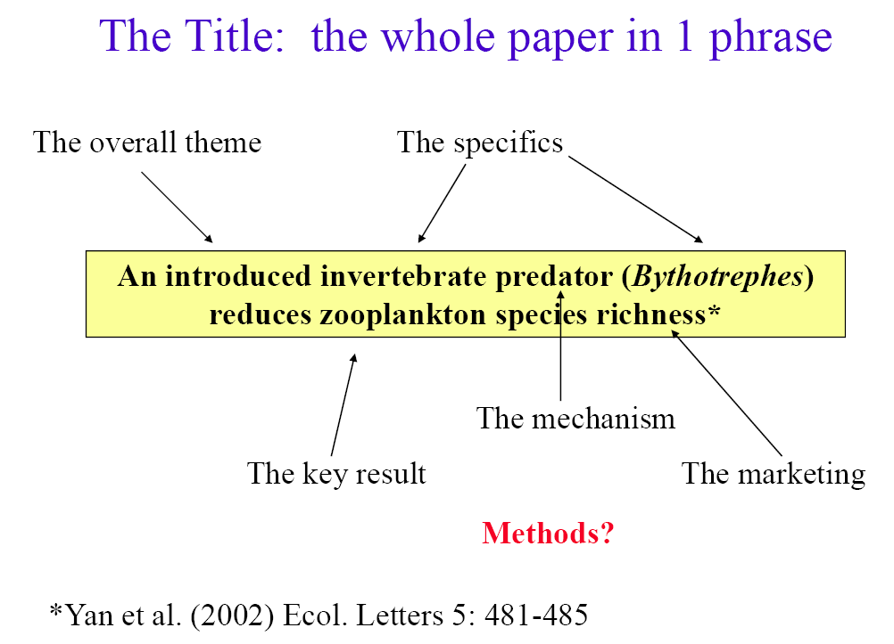
Title

Slide 22
Title
A new live load model for bridges carrying light rail transit

Slide 23
Title
Overall theme; key result, methods, marketing
Identification of geochemical anomalies through combined sequential Gaussian simulation and grid-based local singularity analysis
Effect of soil properties on the dynamic response of simply-supported bridges under railway traffic through coupled boundary element-finite element analyses
Eyes in the sea: Unlocking the mysteries of the ocean using industrial, remotely operated vehicles (ROVs)
Diurnal sea breezes force near-inertial waves along Rottnest continental shelf, southwestern Australia

Slide 24
Titles: Oceanography
An ocean-atmosphere climate simulation with an embedded cloud resolving model
Global warming increases flood risk in mountain areas
Geostrophic dynamics of meridional transport variability in the subpolar North Atlantic
Theme ??
Method ??
Results ??
The title is extremely important and must be chosen with great care as it will be read by thousands, whereas few will read the entire paper

Slide 25
The Abstract
An abstract is a summary of the information in the paper
It is important that the abstract be written clearly and simply, as it is the first and sometimes the only part of the manuscript read.
It should provide a brief summary of each of the main sections (IMRAD) of the paper:
State the principal objective and scope of the investigation
Describe the methods used
Summarize the results, and
State the principal conclusions
It is easier to write the abstract after completion of the paper

Slide 26
Abstract
Overall theme
The North Atlantic meridional overturning circulation (MOC) is believed to play an important role in regulating the Earth's climate. Yet, there is still much uncertainty regarding the dynamics of the MOC and its variability. It is well established, however, that through geostrophy the zonally integrated meridional transport at a particular latitude and depth can be determined from the east-west bottom pressure difference across the basin. Therefore, rather than consider the MOC as a large-scale system, this paper focuses on the dynamics of this geostrophic relationship in two numerical ocean models at a single latitude (50ºN) in the subpolar Atlantic.
The Gap
Specific
theme

Slide 27
Abstract
First, it is shown that the bottom pressure on the western boundary is sufficient to recover, with high fidelity, the interannual meridional transport variability at 50ºN over a 100 year period in the climate model HadCM3. It is found that the variability of western boundary pressure is closely associated with density changes over the continental slope. These changes lead to a large zonal gradient in potential energy and imply an unfeasible depth-mean velocity over the slope. The western boundary pressure, from which the meridional transport can be recovered, is generated as a compensation to this and limits the depth-mean flow.
Results

Slide 28
Abstract
This demonstrates that in numerical ocean models, at least, meridional transport variability is generated as a local response to density changes on the western slope. Whether this is a true representation of actual ocean variability is uncertain, but if it were, then meridional transport variability could largely be determined using only the density field on the western slope.
Implication

Slide 29
Abstract
Hydrological data from a repeated cross‐shore transect obtained using Teledyne Webb Research Slocum Electric gliders offshore Two Rocks in south‐western Australia over 13 months are presented. The data revealed that formation of dense water inshore and its transport across the shelf as a near bed gravity current (defined as Dense Shelf Water Cascade, DSWC) was a regular occurrence, particularly during autumn and winter months. In autumn, the dense water is mainly formed through changes in salinity resulting from evaporation, whilst in winter; temperature change through surface cooling was the dominant factor. The mean wind speeds also decrease during autumn. The speed of the DSWC was estimated to be 0.01–0.02 m s⁻¹, and similar to that measured in other selected regions globally. The offshore transport from the shelf is a significant component of the alongshore wind driven transport.
Method/approach
Results/conclusion
Implication

Slide 30
Abstract
Sea level variability along the Vietnam coast has gained much attention recently due to a range of coastal activities such as navigation, beach erosion and coastal management. Knowledge of the short term sea level oscillations caused by diurnal/semi diurnal tide and storms has been acknowledged through numerous studies, however the number of publications on long-term sea level changes along the Vietnam coast have been minimal. The aim of this research is to examine the role of three processes: (1) impacts of monsoon and river discharge on seasonal sea levels; (2) linkage between ENSO (El Niño and Southern Oscillation) and inter-annual sea levels; and, (3) influence of the 18.6 year nodal cycle and the quasi 4.4 year lunar perigee on high tidal levels by using tide gauge records from PMSL, coastal altimeter data and predicted tides. The seasonal sea level variability in open sea from the Central to southeast coast was mainly controlled by monsoons, whilst in Tonkin Bay was attributed to Red river discharge. The inter-annual variability was governed by ENSO. Particularly, the strong response of sea level to ENSO along open coasts was driven by changes in boundary currents. In contrast, along the north coast, that was strongly affected by 18.6 nodal cycle, will be at high risk of coastal inundation in 2025 because of higher tidal range. High frequency flooding in the low-lying Southeast coast (downstream of Vietnam Mekong Delta) was due to strong winter monsoon in conjunction with interactions in phase between inter-annual sea level variations induced by ENSO and 4.4 lunar perigee cycle. This research contributes to understanding of different processes that contribute to coastal flooding along the Vietnam coast that are related to natural variability. (283 words)
1. General theme | 2. Gap | 3. Specific theme
4. Method/Approach | 5. Principal conclusions | 6. Implication

Slide 31
Introduction
The flow of the Introduction:
Importance
Background
Problem statement
Research gap
Local context
Aims/objectives

Slide 32
Introduction
The flow of the Introduction:
Theme gaps objectives approach
Draft the flow of ideas for the introduction in simple declarative statements that become topic sentences
Total sea level is important in micro-tidal areas
We rarely have long-term data series to examine the different components of sea level variability
Fremantle has the longest time series record of sea level in the southern hemisphere.
Through detailed spectral analysis we can identify the different processes that comprise total sea level

Slide 33
Introduction – last paragraph
In this paper, we use high‐resolution temperature and salinity data obtained along a repeated transect (Figure 1) using Teledyne Webb Research Slocum Electric Gliders to describe the seasonal evolution of the stratification and formation of dense shelf water along the inner continental shelf off south‐western Australia which had not been identified previously.
This paper is organised as follows: Section 2 presents background information on tsunami impacts and tidal characteristics of the study regions (Sri Lanka and Western Australia); methods are presented in Section 3, followed by analysis of the sea-level records for the tsunami events from 2004 to 2007 in Section 4; Section 5 presents an analysis of the continental shelf seiches induced by the tsunami.

Slide 34
Introduction & Study sites
This paper uses a combination of HF radar, moored thermistors, and acoustic Doppler current profilers (ADCPs) to explain the generation and influence of near-inertial oscillations. We used data from these instruments to examine: (1) the forcing, nature, and extent of the diurnal variability of the currents; (2) the vertical and horizontal extents (depths) of the observed counterclockwise motions; and, (3) the effect of the wind forcing and horizontal current shear on near-inertial motions and isotherm fluctuations.
This paper is arranged as follows: Section 2 describes the study area’s oceanographic and meteorological characteristics. Data collection and analysis techniques are outlined in Section 3, with the results presented in Section 4. The results are discussed in Section 5, and the conclusions are presented in Section 6.
2. Study site
The study site is the Rottnest continental shelf, south-west Australia (Figure 1). This microtidal region has a mean spring tidal range of ~0.6 m and diurnal tides [Pattiaratchi and Eliot, 2009].

Slide 35
Introduction & sections
This paper present a new extension to the non-hydrostatic approach to account for the interactions between the waves and a single submerged point absorber (Section 2 Governing equations, 3 Numerical implementation). To demonstrate the capabilities of the approach in simulating these interactions and the wave-induced response of the submerged device, model predictions are compared to an analytical solution based on potential flow theory for linear waves, and laboratory and numerical experiments for nonlinear wave conditions (Section 4). This work thereby provides the first step towards simulating the interactions between the waves and a WEC at the scale of a realistic coastal region using a non-hydrostatic wave-flow model (Section 5 Discussion, 6 Conclusions). Although the present work focuses on submerged point absorber devices, we envision that the numerical approach can be expanded to include other devices (e.g., floating point absorbers, bottom-mounted flaps, and oscillating water columns), pushing our modelling capabilities towards accurate predictions of large-scale impacts by arrays of generic WECs.

Slide 36
Methods
The Reader must be told why each method is needed, why it was selected in preference to others.
Provide an overview of the approach
Long-term field data (sea level) analysis through spectral analysis.
Numerical modelling and satellite altimetry to highlight/identify different processes.
Describe the particular methods
Field and/or analytical techniques
e.g. Sea level recording techniques, Fast Fourier Transform method, Wavelet transforms, how they were calculated, error bars, confidence intervals
Refer to other literature as much as possible

Slide 37
Results
The flow of the Results with use of simple declarative statements and one idea/paragraph
There are a range of periods which control sea level variability from hours to centuries (General statement)
The difference between lowest and highest recorded water levels is 2.0 m
The mean tidal range is ~0.5m. Storm surges, locally and/or remotely generated have a similar magnitude
The largest influence is through diurnal tides and storm surges
etc
Etc
Note: Results section does not usually include any references.

Slide 38
Simple declarative statements
*
Y
*
*
*
*
X

Slide 39

Simple declarative statements

Slide 40
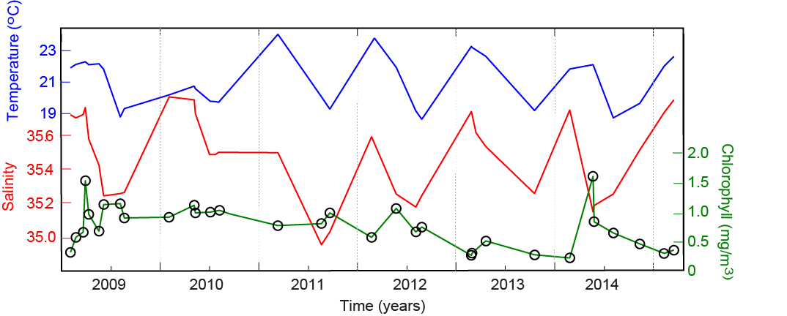
Simple declarative statements

Slide 41
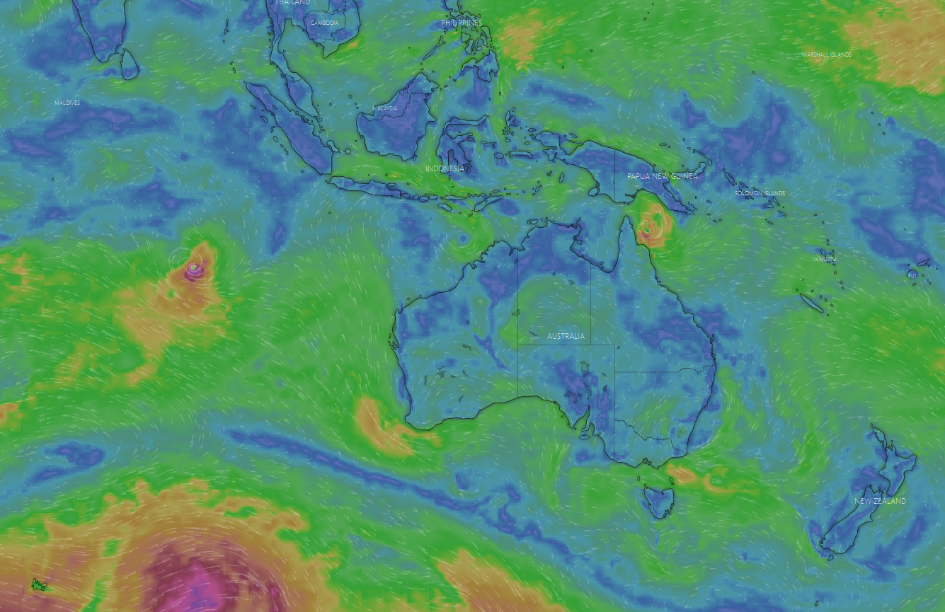
Simple declarative statements

Slide 42
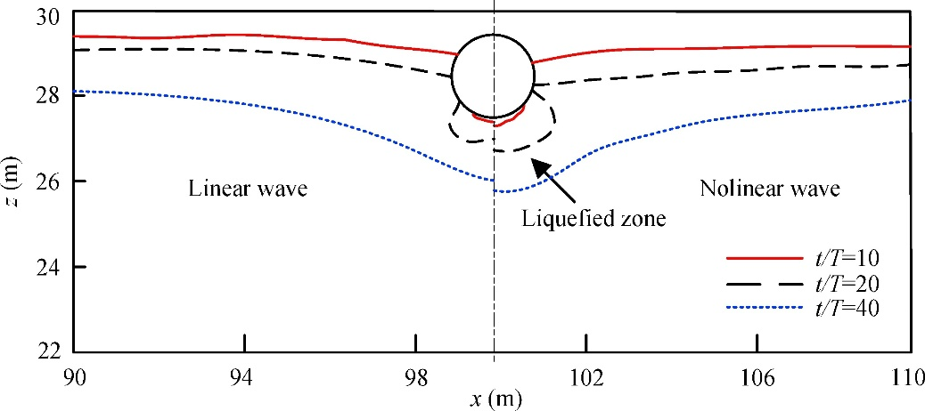
Wave-induced dynamics of marine pipelines in liquefiable seabed
Time histories of development of liquefaction zone in the vicinity of the pipeline under a linear wave (on the left side) and under a nonlinear wave (on the right side).

Slide 43
Results – first paragraph
Cross‐shore transects along the Two Rocks line showing the temperature, salinity and density distribution observed between January and May 2009 (summer and autumn, 6 transects) are shown in Figure 2. Over the 13‐month period, temperature on the inner shelf ranged between 18.4° and 22.2°Celsius, with the minima occurring during winter (August). Throughout the year, the offshore waters were warmer compared to the nearshore waters due to the influence of Leeuwin Current offshore and Capes Current advecting colder water onto the shelf during the summer.

Slide 44
Write about your results
(not your tables, figures, and statistics)
Confusing and disjointed Results sections often arise because the writer does not have a clear idea of the story she/he intends to tell. When preparing to write your results, decide on the elements of the story you wish to tell, then choose the subset of text, figures, and tables that most effectively and concisely conveys your message. Organize this subset of tables and figures in a logical sequence; then write your story around them.

Slide 45
Figure Captions
Captions should not merely name a table or figure, they should explain what is contained in it.
A caption (figure or table heading) should contain sufficient information so that a reader can understand a table or figure, in most cases, without reference to the text. Very simple tables and figures may require only a title for clarity, and exceptionally complex ones may require reference to the text for explanation.
Do not leave caption writing to the end of the paper; write captions when you organize your Results section and it will help you write the text.
Always label panels Figure 1a,b etc.

Slide 46
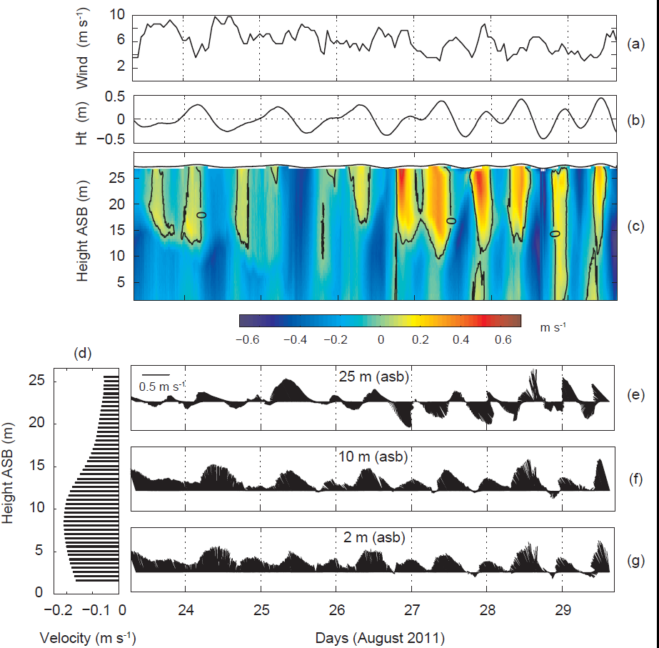

Slide 47
Discussion
Justification/Explanation – provides support for the main result (‘message’)
Significance – This result is unique, i.e. a range of processes control the total sea level at different time scales. As they all have amplitudes ~0.20m they are all important
Context – how does your results relate to other work ?
Implications
Long time series required to identify longer-term changes
Beach stability and coastal flooding
Long-term tidal changes are important when considering sea level rise due to global warming

Slide 48
How to write the Discussion
It is the hardest section to write.
Its primary purpose is to show the relationships among observed facts
It should end with a short summary or conclusion regarding the significance of the work.

Slide 49
Components of the discussion
Start with a broad summary of the results and highlight the ‘message’
Try to present the principles, relationships, and generalizations shown by the Results
Point out any exceptions or any lack of correlation and define unsettled points
Show how your results and interpretations agree or contrast with previously published work
Discuss the theoretical implications of your work, and any possible practical applications.
End with either implications or a conclusion paragraph

Slide 50
Conclusions
List the main conclusions as a summary either as a paragraph or dot-points
Key message and findings
Highlight the significance and implications (‘big picture’)
Main contribution
Do not introduce new ideas/data here - – no references

Slide 51
Paper rejection reasons
Why ? | Tip
missing a clear and well-defined research question or objective | Clear description of the objectives – repeat the message as many sections as possible
Does not adequately include existing literature or fails to establish research gap | Explicitly state how the contributes to the field fills a gap – in Introduction and Discussion
Does not add new knowledge or insights | Highlight the unique contributions and explain why it is significant
Has grammatical errors, unclear language or poor organisation | Proof read carefully. Ask a colleague
Results do not align with the research question or conclusions are not supported by data | Clearly present the findings, discuss the implications highlight the evidence
Fails to discuss the broader implications of the findings or how they advance the field | Clearly articulate the significance of your findings and suggest practical or theoretical implications for future research

Slide 52
Summary tips:
Highlight
the message
major findings
contributions: clearly state the novelty, significance and implications
Check
Ensure the paper meets all journal requirements
Proofread;
Feedback from peers, mentors and/or colleagues

Slide 53
Class Project
State the key scientific objective in your research
Construct a graph which shows your “preferred” results.
Write the simple declarative statement which tells the reader the graph’s key message
Write the topic sentence, and the entire paragraph describing this graph
Write your name on top of paper and pass onto your colleague

