Slide 1
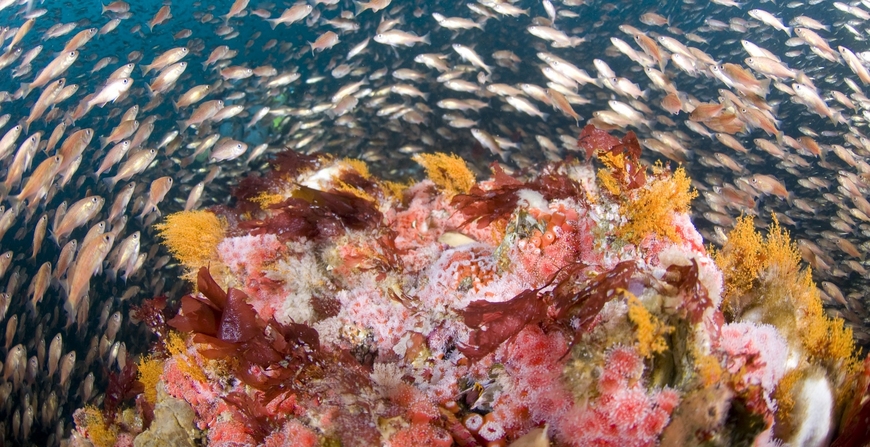
Introduction to Oceanography: Basics of Marine Ecology
Photo: Joe Hoyt, NOAA, in the public domain
Notes:
As we look at this image of a lovely coral reef, we can see that it is a complex ecosystem of not just the coral animals themselves (and yes, corals are animals), but also many organisms that attach to the coral reef and the fish swimming around the reef. What kind of animals are these? What are the relationships between them? Also, all animals need to eat. Where are they getting their food? We’ll try to answer these questions today as we explore the basics of marine ecology.

Slide 2
After this lesson you should be able to:
Define important terms related to how organisms live in the ocean.
Apply the appropriate terms to selected marine organisms.
Explain the relationships between different types of organisms in a marine environment.
Notes:
Before we begin, here are some learning outcomes for today’s lesson. After you work through the material and practice in class, come back and review to see if you have accomplished these goals. You should be able to not only define some new terms, but also apply them to specific organisms and also identify the relationships between organisms in a marine ecosystem.

Slide 3
Unicellular & multicellular life
Who lives in the ocean?
Notes:
Let’s start first by defining what types of organisms live in the ocean. If you asked most people to list types of life, they might list plants and animals. But in reality those are only two small categories of life, and there are many more. One of the most fundamental distinctions we can make is between life forms that are composed of only a single cell, and those that are composed of more than one.

Slide 4
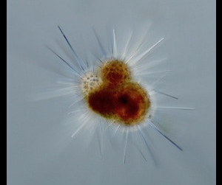
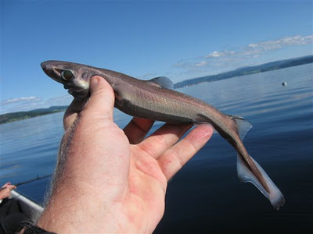
Marine life forms can be single-celled or multi-celled
Foraminiferans are protozoans, single cells that secrete an elaborate external shell.
Image: NOAA, in the public domain.
The dwarf lanternshark is the smallest known shark. Nonetheless, it contains millions of cells. Image is licensed under the Creative Commons Attribution-ShareAlike 3.0 License.
Notes:
Single-celled life forms are usually very tiny, so they are easy to overlook, and might not even be visible without a microscope. So while we tend to think of marine animals, like sharks, when we think about life in the ocean, in reality the vast majority of life forms in the ocean are neither animals nor multi-celled, and are groups you’ve probably never heard of like this foraminiferan on the left. It is neither a plant nor an animal, but a member of a group called the protozoans, which are all single-celled, and very abundant in the ocean.

Slide 5
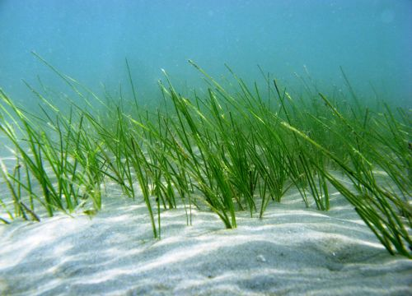
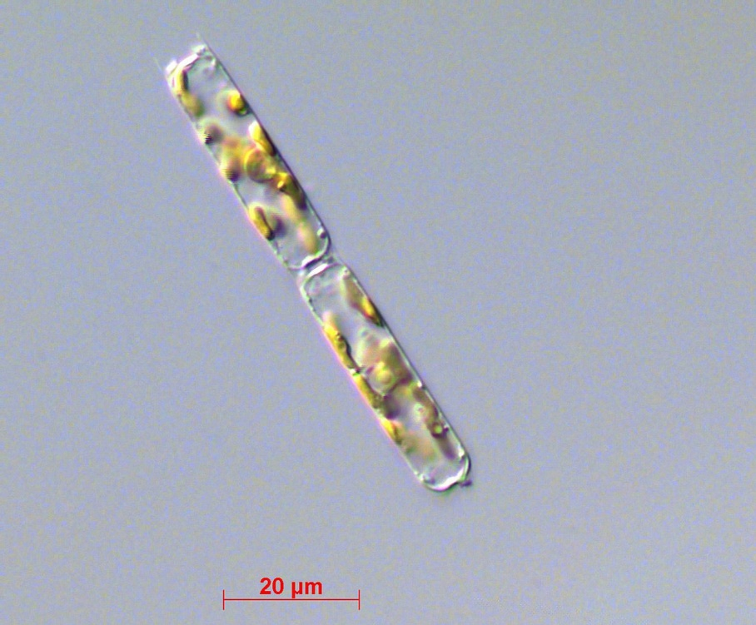
Fun fact: on land photosynthesis is carried out mostly by plants, but in the ocean single-celled organisms are largely responsible.
Seagrass
Images: NOAA
Two diatoms, each a single cell
Notes:
Most of us learned in school about how plants photosynthesize, so we tend to think of plants when we think of photosynthesis, but while there are some marine plants like the seagrass on the left, most organisms that photosynthesize in the ocean are not plants at all, but members of a number of groups of single-celled organisms, such as the single-celled box-like diatoms on the right. Each of these is an independent organism comprising a single cell, despite the fact that they are attached to each other.

Slide 6
Prokaryotes are cells with no nucleus and very simple structure. They are always single-celled.
Eukaryotic vs. Prokaryotic cell
Figure : National Center for Biotechnology Information, public domain
Notes:
Cells can be simple or complex. The most simple type of cell is called a prokaryote. This type of cell has genetic material, but this material is not contained within a nucleus. It also has a rather inflexible cell wall and does not have specialized structures within the cell. All prokaryotic organisms are single-celled. Even though sometimes they attach to each other to form colonies, each cell is a separate organism.

Slide 7
Eukaryotes have a membrane-bound nucleus, specialized structures (plastids, mitochondria), and are unicellular or multicellular
Eukaryotic vs. Prokaryotic cell
Figure : National Center for Biotechnology Information, public domain
(Read more about cells here)
Notes:
In contrast eukaryotic cells DO have a nucleus that houses their DNA, their cell wall is more flexible, and they have specialized structures with their cell, like mitochondria and plastids. While many eukaryotic organisms are single-celled as well, eukaryotes include the multi-celled forms of life, including animals, plants, and fungi. Both prokaryotes and eukaryotes-single and multi-celled-are important members of the marine ecosystem.

Slide 8
MARINE HABITATS
Where do organisms live in the ocean?
Notes:
Let’s next turn our attention to where in the ocean these organisms are living. Life would be pretty different for a shark swimming around in the water than it would be for seagrass, attached to the seafloor.

Slide 9
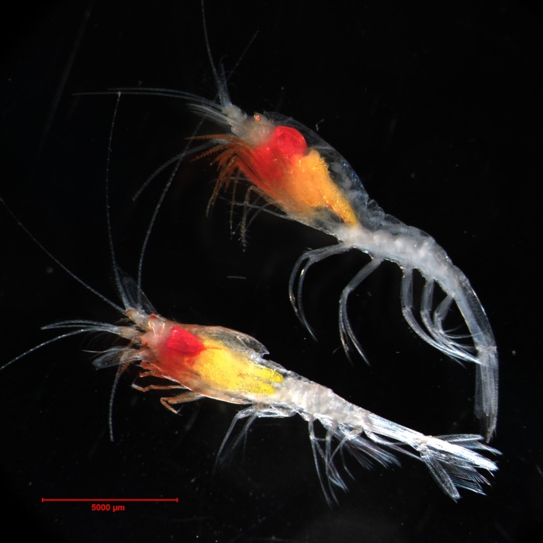
Plankton don’t swim faster than the current, and are usually small
These tiny shrimp are about 2mm long.
Photo: Hidden Ocean 2005 Expedition: NOAA Office of Ocean Exploration
Notes:
If I asked you to make a list of things that live in the ocean, you’d probably list big or exotic animals like sharks, dolphins, sea turtles and maybe even seahorses. But most animals in the ocean aren’t capable of deliberately swimming from place to place like a sea turtle. Instead, they go wherever the current takes them, either because they aren’t strong swimmers, or perhaps don’t swim at all, but merely float. These tiny shrimp have legs, so CAN swim, but they are so tiny at only about two millimeters long that they cannot swim against the current. Any organism that falls into this category is a member of the plankton, whether it is an animal or not.

Slide 10
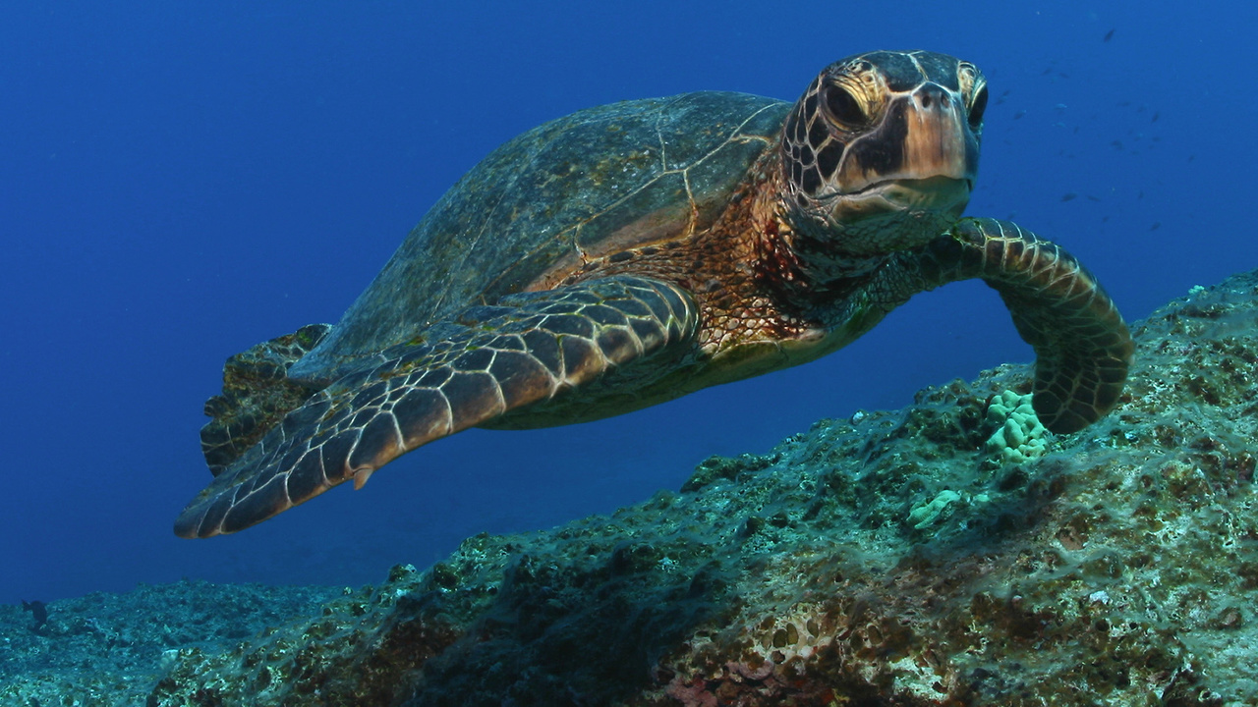
Animals that can swim faster than the current are nekton
The sea turtle is a member of the nekton.
Image : NOAA
Notes:
The animals that CAN swim against the current are members of the nekton. While much more visible, this group of organisms is much less abundant in the ocean that the usually much smaller plankton.

Slide 11
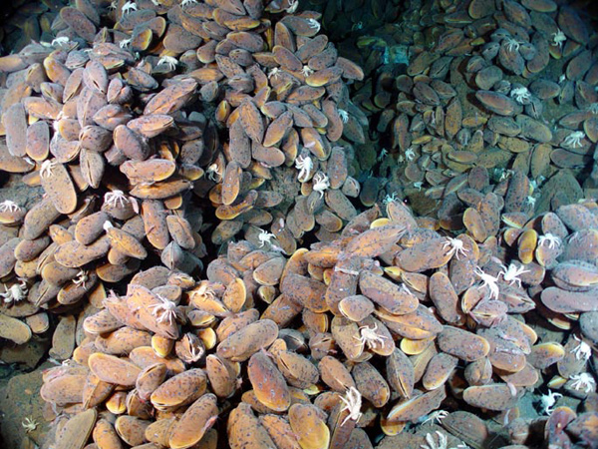
Organisms that live on the seafloor are members of the benthos
The benthos lives in the benthic realm, either ON the seafloor, or burrowing into it.
Mussels on the seafloor (with small white crabs)
Image: NOAA image
Notes:
Animals that live on the seafloor are called the benthos. Some of them just sit on the seafloor, but other attach to the seafloor like these mussels that were photographed near a mid-ocean ridge. And some dig into the seafloor instead, like clams, a close relative to these mussels. All of these are ways to be members of the benthos.

Slide 12
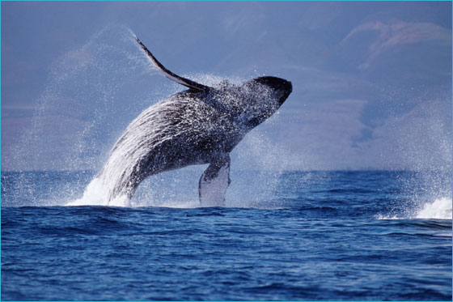
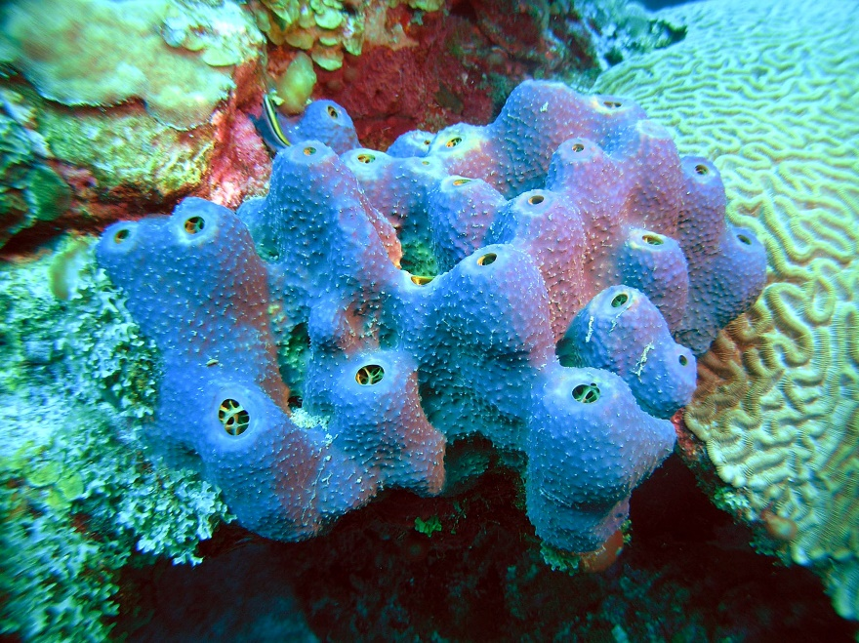
We also distinguish pelagic and benthic organisms
Pelagic organisms, like this whale, live IN the water column.
Photo: Doug Perrine, NOAA
Pelagic organisms, like this sponge, live ON the seafloor.
Photo: NOAA
Notes:
We can also make a distinction between the organisms that are living in what we call the water column, meaning the water between the sea surface and the seafloor, and those that spend all or most of their lives on the seafloor itself. The former are pelagic and the latter are benthic.

Slide 13
Think, pair, share: Are all members of the benthos benthic?
Notes:
Here’s a question to think about. Pause the video if you want to think for a bit. (Pause.) The only difference here is that benthos is a noun that refers to a group of marine organisms that spend their lives on the seafloor, and “benthic” is an adjective that we can use to describe them.

Slide 14
Think, pair, share: Which organisms are pelagic?
Notes:
Here’s another question to think about. Pause the video if you want to think for a bit. (Pause.) When we use the adjective pelagic we are referring to organisms that spend their lives in the water between the sea surface and the seafloor, so that includes both the plankton AND the nekton.

Slide 15
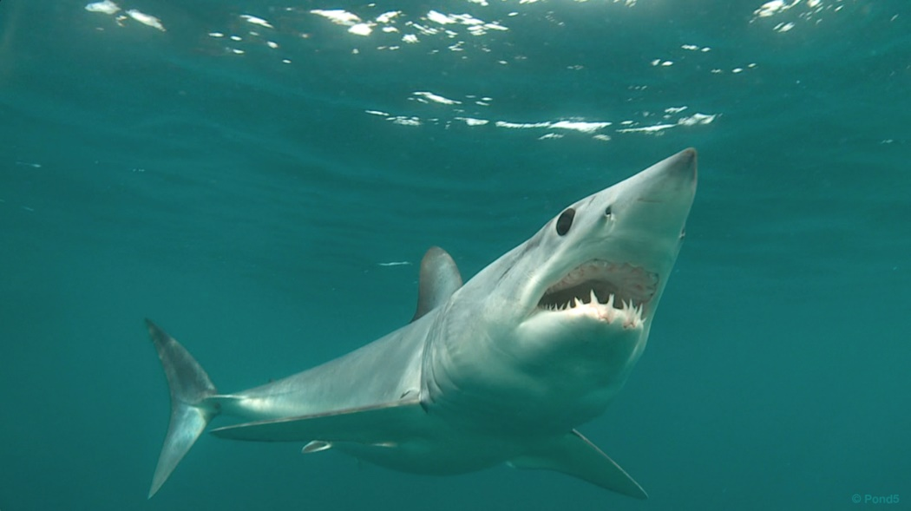
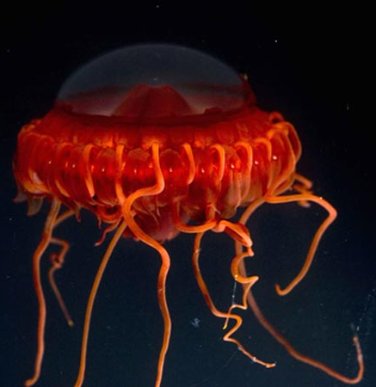
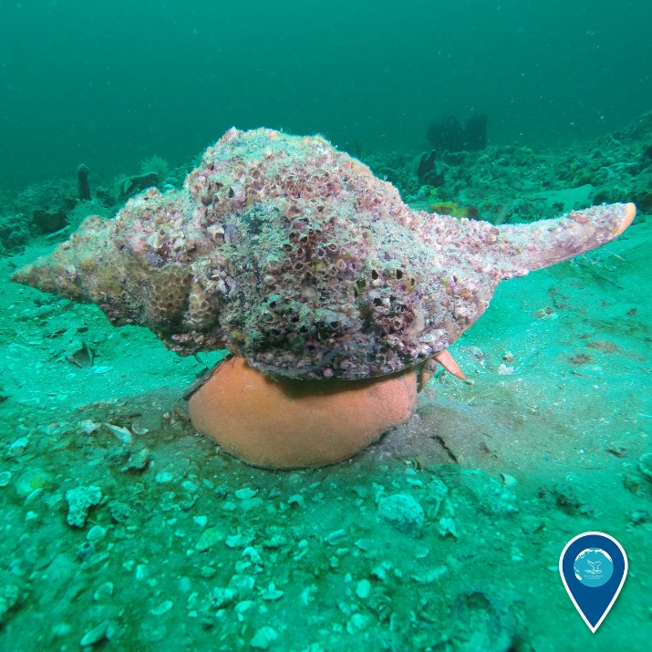
Practice problem: Match the picture to the term.
Plankton
Nekton
Benthos
1.
3.
2.
All images: NOAA
Notes:
Let’s make sure you understand these three terms before we move on. Examine the marine organisms shown in the pictures and match up the terms to the pictures. Pause the video while you complete this task. (Pause.) Picture 1 is of a shark. The shark is a strong swimmer that spends its time in the water column, so it is a member of the nekton (B). Photo 2 shows us a conch, a type of marine snail. It crawls around on the seafloor looking for other snails to eat, so is a member of the benthos (C). And figure 3 shows us a jellyfish, which floats with the currents, so is a member of the plankton (A).

Slide 16
Trophic strategies
How do organisms feed in the ocean?
Notes:
Next let’s think about how organisms feed in the ocean. We call these trophic strategies. The root word of trophic means “nourishment” or “food”.

Slide 17
Autotrophs create organic molecules; heterotrophs do not
Autotrophs
Heterotrophs
O₂
oxygen
+
+
(CH₂O)_{n}
organic carbon
(CH₂O)_{n}
organic carbon
Inorganic nutrients
chlorophyll
Biologic processes & heat
solar energy
H₂O
water
H₂O
water
+
+
CO₂
carbon dioxide
Notes:
As I mentioned earlier, most people would only name plants and animals if asked to describe different types of life. Let’s think about the difference between the two. Plants use energy from the sun to combine carbon dioxide and water to make a sugar molecule, organic carbon. They can do this because they have a pigment in their cells called chlorophyll. They also need certain elements that we call inorganic nutrients. We’ll talk about them in a later lesson. We call organisms like plants that make their own food autotrophs, meaning “self feeding”. But as we previously discussed, most autotrophs in the ocean are not plants. Animals on the other hand use oxygen, a byproduct of photosynthesis, to break the organic carbon molecule apart. They use the energy released, and carbon dioxide and water are also eventually released. To a certain extent that’s what is happening when you exhale. We call organisms like animals heterotrophs, meaning “other feeding”.

Slide 18
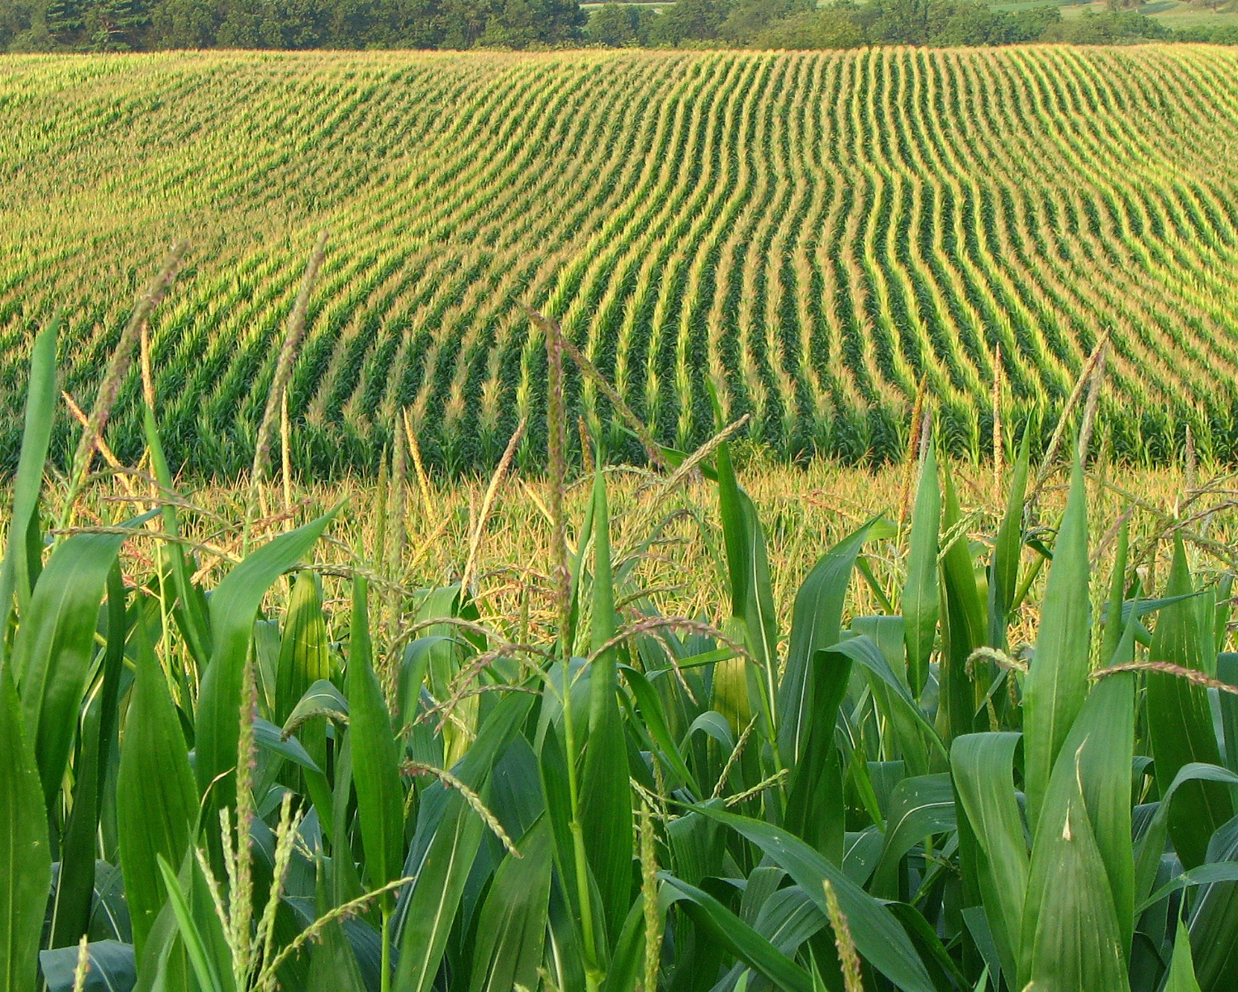
Autotrophs are responsible for primary productivity; they produce the food that is used by themselves and other organisms
This Photo by Unknown Author is licensed under CC BY
Notes:
Autotrophs are responsible for what we call “primary productivity”. This cocncept is probably easier to visualize if we think about what happens on land. Ultimately our food, which provides us with energy, comes from plants. This corn might be turned into tortilla chips, or it might be fed to a cow, which might end up being your lunch time hamburger. The same system of energy being distributed from the primary producers into the rest of the ecosystem happens in the ocean as well, even though it more likely to be single-celled organisms that are producing the energy rather than corn plants.

Slide 19
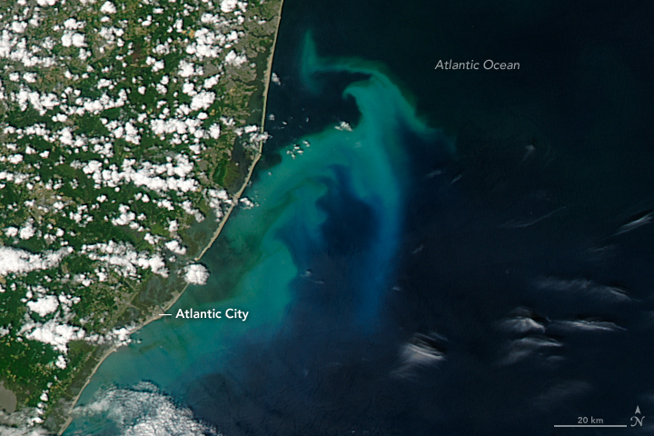
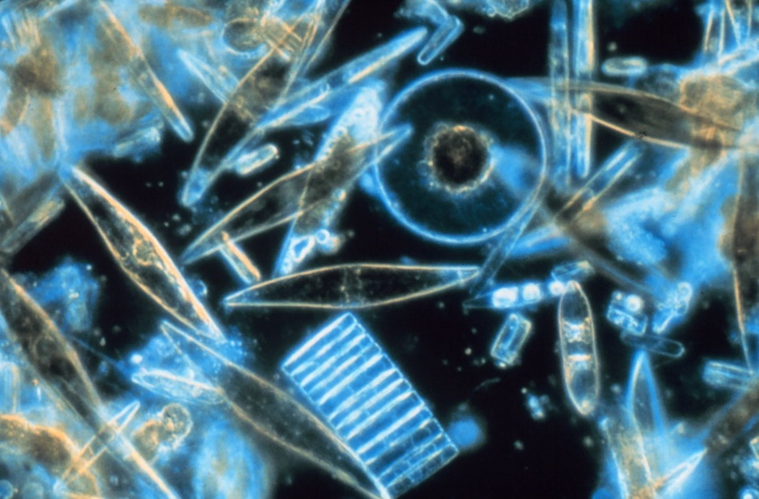
Photoautotrophs carry out photosynthesis, with oxygen as a byproduct
Single-celled photosynthetic organims as seen under the microscope
Image: NOAA
Single-celled photosynthetic organisms from space (the greenish color in the water).
Image: NASA Earth Explorer
Notes:
The majority of the primary producers that live in the ocean are single-celled organisms like the ones seen under the microscope here. Despite being very tiny, in some circumstances they are so abundant that they color the water green and can be seen from space, as see in the satellite image to the right. Photosynthesizers are photoautotrophs, meaning that they require energy from the Sun to be autotrophs.

Slide 20
Think/pair/share: What is the major limitation on photosynthesis in the ocean?
Notes:
So knowing what we know about photosynthesis, what is the major limitation of photoautotrophy in the ocean environment? (Pause) Several limitations exist, including the need for inorganic nutrients. But the major limitation is the need for sunlight. Photoautotrophs can’t photosynthesize without it! Yet most the ocean is deep and dark, with no available sunlight.

Slide 21
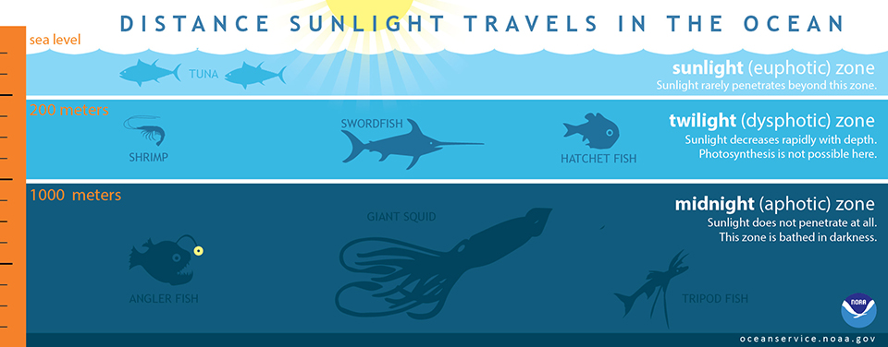
Photosynthesis can only happen in depths to which sunlight can penetrate, called the photic zone.
Figure: NOAA
Notes:
In the ocean, photosynthesis is only possible where sunlight is available because energy from the sun is needed to break the strong bonds of the water molecule. In clear ocean water this is usually at 200 meters and above. Below 200 meters there is a zone where there might be enough light for the animals to barely see each other, but it’s not enough for photosynthesis, and once you get below 1000 meters, no sunlight is present at all. If the ocean water is muddy, then the bottom boundary of the photic zone will be even closer to the sea’s surface.

Slide 22
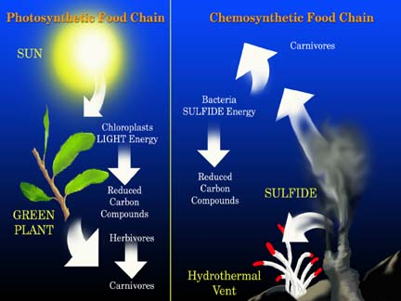
Chemosynthesis is autotrophy using the H₂S rather than H₂O, which is easier (Chemoautotrophy)
This process does not require sunlight or chlorophyll, and probably evolved before photosynthesis
Figure: NOAA
Notes:
But there’s another possibility for being an autotroph, one that you’ve probably never heard of, and one that scientists have known about for only about 50 years. This is chemoautotrophy. This process uses hydrogen sulfide in place of water. This molecule is easier to break down, so energy from the sunlight is not needed, just a steady supply of hydrogen sulfide molecules. This is a process that can happen deep within the ocean!

Slide 23
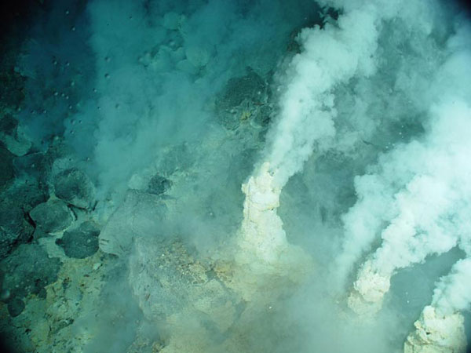
At vent communities, first discovered in 1977, chemosynthesis using H₂S is the base of the food chain
Click here for a video lesson about vent communities
Image: NOAA
Notes:
You might remember that mid-ocean ridges are divergent plate boundaries where volcanic activity happens regularly. Even when volcanic activity is not happening, the rocks there are very hot, and we get a lot of hydrogen sulfide released. It is used by chemosynthetic organisms (chemoautotrophs) to support an entire community of organism based on this primary productivity. In the picture we see something called a “smoker”, which is releasing hydrogen sulfide along with other compounds and materials.

Slide 24
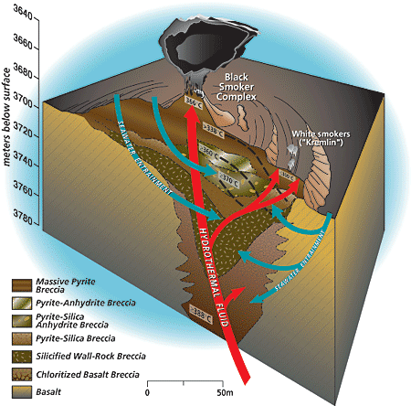
The H₂S is from seawater circulating around the hot rocks of the mid-ocean ridge
Figure from Oceanus magazine
Figure: Woods Hole Oceanographic Institute, in the public domain
Notes:
The “smokers” are places where really hot water is being released into the ocean. The water seeped into the mid-ocean ridge through cracks in the rocks. It got heated up and as it heated, compounds including hydrogen sulfide were dissolved into it from the surrounding rocks. Once this superhot water goes back into the ocean through the smoker, it has lots of chemicals dissolved in it. So why so the smokers “smoke”? What you are seeing is not smoke at all but tiny bits of mineral material that are forming as the water cools down quickly. Some of the dissolved compounds start to react with each other to form solids as the water quickly cools down. Depending on which minerals are forming, the “smoke” may be black or white, giving us white smokers and black smokers. Both are also referred to as hydrothermal vents.

Slide 25
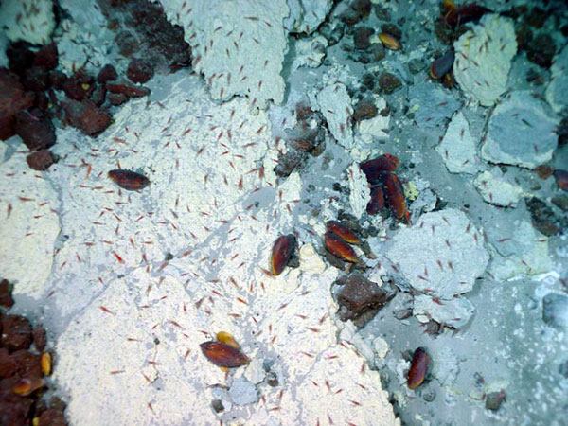
Microbial mats then serve as food for grazing organisms
Shrimp and Mussels feed on a microbial mat near a hydrothermal vent.
Photo: NOAA Ocean Explorer
Notes:
Instead of plants in the communities around mid-ocean ridge hydrothermal vents we find microbial mats. As you can see in the picture, the heterotrophs are busy feeding on it!

Slide 26
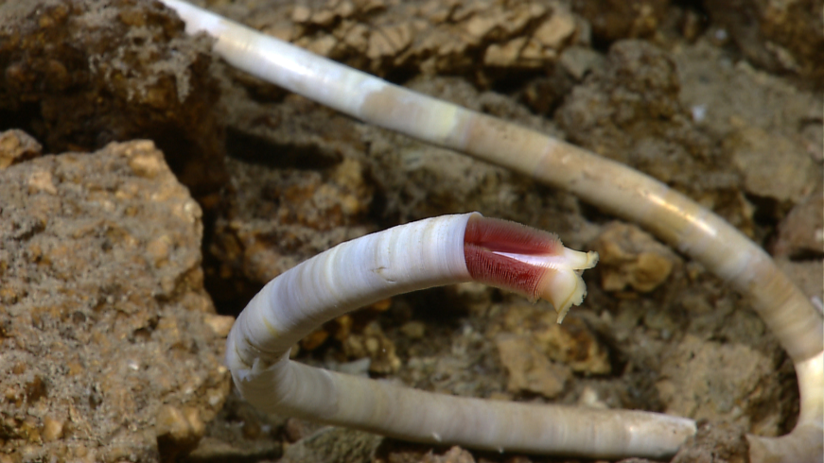
Tube worms have no gut but are dependent on symbiotic bacteria within their tissues
The tube worms transport sulfide to bacteria, which then produce organic particles used as food by worm
A tubeworm at an Atlantic thermal vent
Image: NOAA Okeanos Explorer Program, MCR Expedition 2011, NOAA-OER)
Notes:
One really weird animal that we often find in chemosynthetic-supported marine communities is the tube worm. Tube worms are indeed a form of worm that surrounds themselves with hardened tube for protection. Like all animals they are heterotrophs, but they do not have a gut for digestion. Instead they have chemoautotrophs living inside their tissues. They are able to take in and transport the hydrogen sulfide to the chemoautotrophs, who then produce organic carbon, some of which provides nutrients for the tube worm. A relationship like this which represents a close relationship between two organisms is called a symbiotic one. Once scientists discovered chemosynthesis, they were surprised to find that these communities are quite common along mid-ocean ridges.

Slide 27
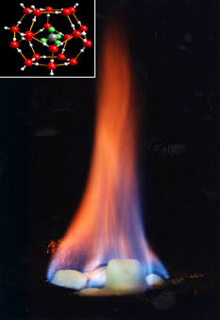
Chemosynthetic organisms can also be associated with methane seeps (“cold seeps”)
Gas hydrates are molecules of methane encased by water molecules and look like ice. The methane comes from bacterial activity &/or natural gas deposits in rocks below
More about these communities in the Gulf of Mexico: click here
USGS figure via Wikipedia
Notes:
But a few decades later, they discovered that chemosynthesis does not just happen in the hot volcanic areas of the mid-ocean ridges. This type of community can also be found in places where the gas methane is accumulating on the seafloor. In the cold deep parts of the ocean methane gas plus water form an ice-like substance. Even though it looks like ice, it’s actually like a cage of water molecules surrounding a methane molecule, which is CH₄. In the smaller figure the green and grey molecule is the methane and the grey and red ones are the water molecules. So even though it looks like ice, it will burn as shown in the figure, because methane gas is very flammable. So where did the methane come from? Some of it is from the activity of organisms. For instance when you digest food you produce methane gas. But some of it is seeping to the surface from oil and natural gas deposits in rocks far below the surface. The methane often also has hydrogen sulfide associated with it, and both gases can be used for chemosynthesis. These areas are referred to as cold seeps. They are very cold as compared to the mid-ocean ridge hydrothermal vents.

Slide 28
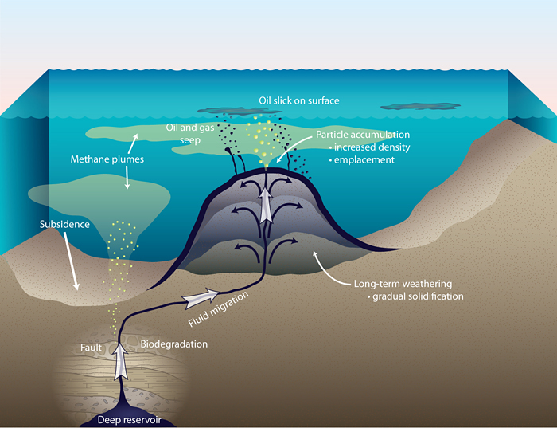
Oil and gas in rocks beneath may seep upward, especially along breaks in the rocks
Oil and gas migrating towards the surface to form an oil seep.
Figure: Woods Hole Oceanographic Institute, in the public domain
Notes:
These cold seeps are especially common in areas where the oil and natural gas trapped in rocks beneath the surface migrate upwards along natural fractures in the rocks called faults. Where these faults intersect the seafloor, the constantly escaping gases provide the chemicals needed for chemosynthesis.

Slide 29
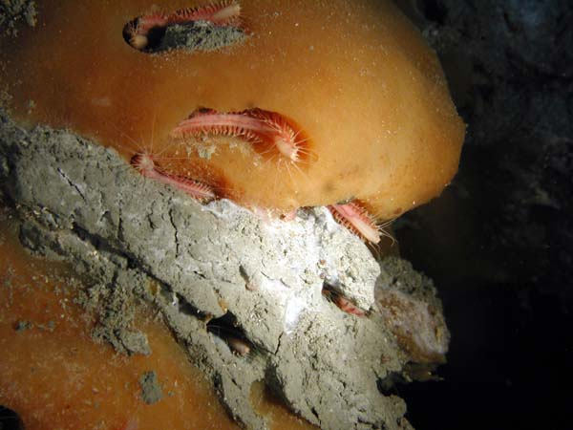
“Ice worms” feed on the bacteria which live on the hydrates
The orange gas hydrate is home to Hesiocaeca methanicola, a newly discovered species of marine worm found in the Gulf of Mexico in 1997. This lobe of hydrate was exposed on the seafloor.
Image courtesy of Deep East 2001, Ian MacDonald, NOAA/OER.
Notes:
Like the hydrothermal vent communities, sometimes these cold seep communities look like something from outer space! Here we see a ice-like blob of gas hydrate. Microbial mats are using the gas trapped within the ice for chemosynthesis, and these pink “ice worms” are feeding on the microbial mats. These “ice worms” live only in chemosynthetic communities, despite being heterotrophs.

Slide 30
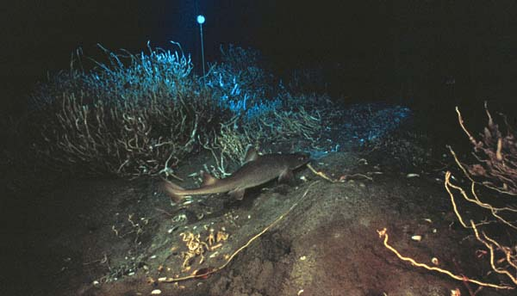
Tube worms can also be found at cold seeps
Shark swimming around cold seep tube worms on the floor of the Gulf of Mexico. More about cold seep tube worms here.
Image courtesy of Gulf of Mexico 2002, NOAA/OER
Notes:
Just like at mid-ocean ridges, we also often find vast thickets of tube worms, as seen here in the Gulf of Mexico. The ice worms and tube worms only live in chemosynthetic communities, but because there is such an abundance of life here, organisms that are not confined just to chemosynthetic communities show up as well, like the shark seen swimming though the tube worms.

Slide 31
Lifestyles & trophic Strategies
How do organisms live and feed?
Notes:
Let’s return for a few minutes to the terms used earlier to describe how organisms live in the ocean. We distinguished nekton, which swim strongly, and plankton which don’t. But both are considered pelagic organisms because they live in the water column, whereas organisms that live on the seafloor are the benthos. So let’s particularly explore trophic strategies among the plankton, which are by far the most abundant organisms in the ocean.

Slide 32
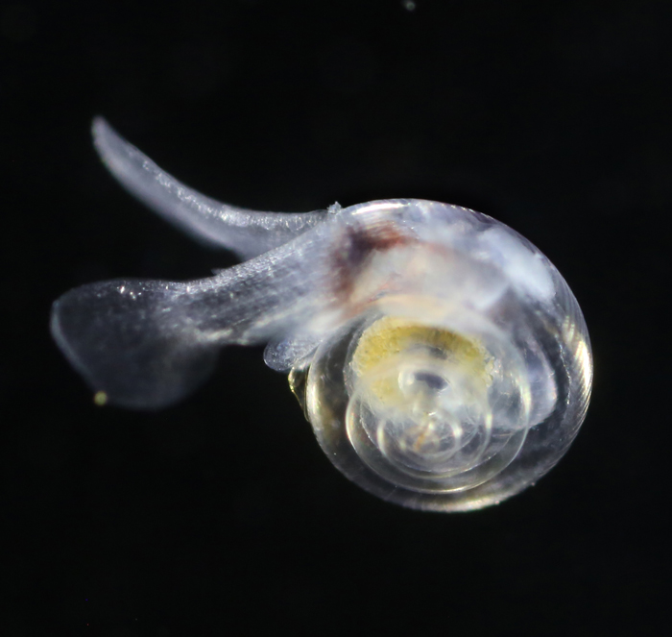
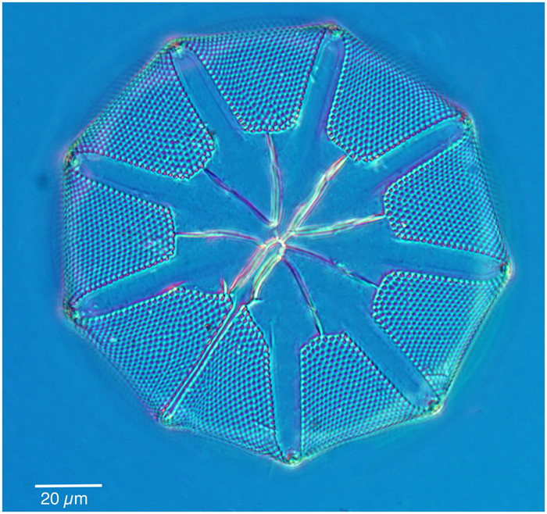
Plankton can be classified by their trophic strategies
Phytoplankton are photosynthetic
Zooplankton are heterotrophic
Images: diatom, left, NOAA image library Courtesy of Dr. John R. Dolan, Laboratoire d'Oceanographique de Villefranche; Observatoire Oceanologique de Villefrance-sur-Mer; pteropod, left, NOAA image library
Notes:
We’ve already talked multiple times about how most of the photosynthesis in the ocean is carried out by single-celled organisms like this diatom on the left. They are members of what we call phytoplankton. Zooplankton is the term for multi- or single-celled eukaryotes that are heterotrophic. Many of them are animals (or multi-celled eukaryotes) like this tiny marine snail. But some zooplankton are single-celled eukaryotes and therefore not classified as animals even though they ARE heterotrophic.

Slide 33
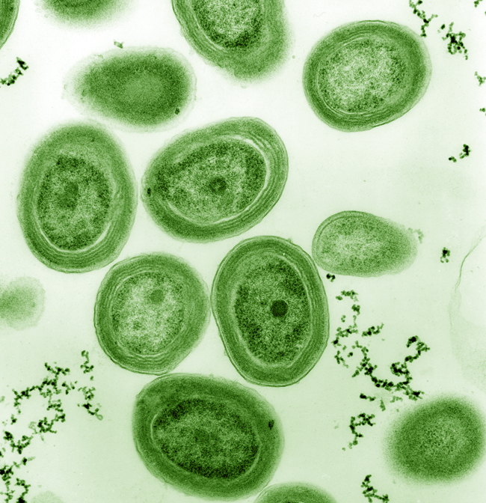
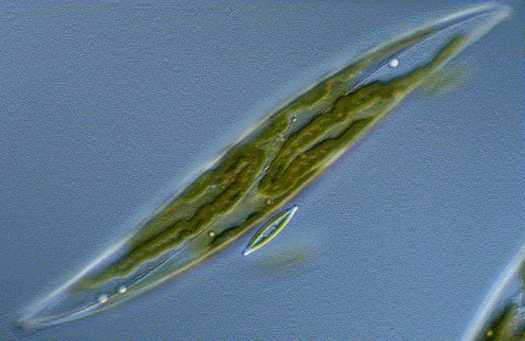
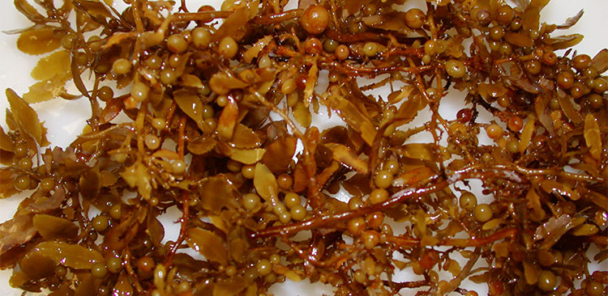
Phytoplankton include both prokaryotes & eukaryotes
Diatoms are single-celled members of the of the phytoplankton.
Image: NOAA
Prochlorococcus is a prokaryotic member of the phytoplankton.
Image: US Department of Energy, in the public domain
Sargassum is a multi-celled member of the phytoplankton.
Image: NOAA
Notes:
Phytoplankton, like zookplankton, can be single-celled, like this diatom, or multi-celled like this floating algae called Sargassum. Unlike the zooplankton, which only includes eukaryotes, not prokaryotes, the group phytoplankton includes photosynthesizing prokaryotes, the oldest photosynthesizing group on our planet.

Slide 34
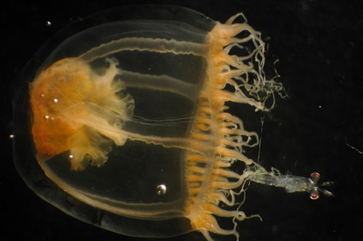
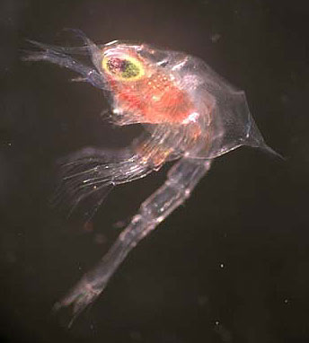
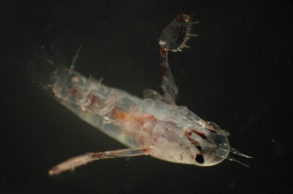
Zooplankton are eukaryotes, both single- and multi-celled
Some are permanent members of the plankton; others are larvae.
Small jellyfish, including their larvae are planktonic.
Image: NOAA
Crab larva are planktonic.
Image: NOAA via Wikipedia
Copepods (Left) and Pteropods (right) live their whole lives as plankton.
Images: NOAA
Foraminifera are protozoans (single-celled).
Image: NOAA
Notes:
So while most of the zooplankton that we might think of, like jellyfish, are animals, the group includes single-celled organisms like this foraminiferan, which is a protozoan. Despite being a single cell, some of them can actually prey on very small multicelled zooplankton, like the copepod shown here, which is a crustacean, the group that also includes shrimp and lobsters.

Slide 35
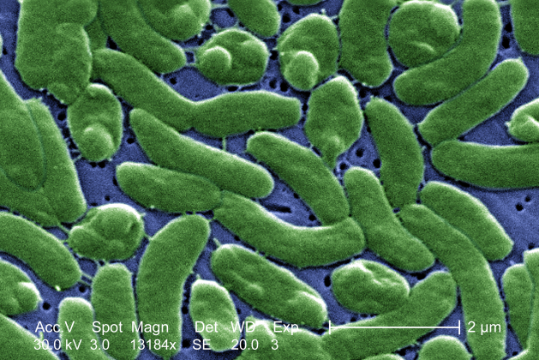
Heterotrophic prokaryotes are classified as bacterioplankton
They are important in breaking down organic matter, releasing nutrients for other organisms, plus CO₂
Vibrio vulnificus occurs in nearshore marine environments and can make you very sick if you ingest it or are in contact with it. Image: Center for Disease Control
Notes:
So we specifically excluded the prokaryotes from the group we call zooplankton. So where do we put them? We refer to this group as the bacterioplankton. The bacterioplankton are easy to overlook, but they are really important parts of the marine community. As they scavenge and metabolize organic matter, they are responsible for its breakdown and the release of CO2 and inorganic nutrients back into the water. The decay of dead organic material is undertaken by the bacterioplankton in the pelagic realm.

Slide 36
PRACTice problems
Let’s practice what you’ve learned!
Notes:
Alright, we have learned a bunch of terms, and while it’s important to know their definitions, it’s even more important to be able to apply them. Let’s do a few practice problems and if you have trouble, you might want to go back to review.

Slide 37
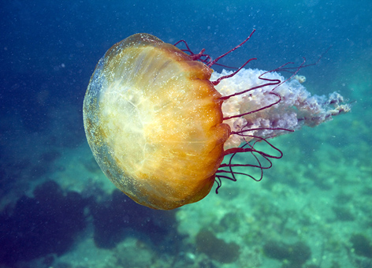
Practice problem: Which terms apply?
Pelagic
Benthic
Jellyfish
NOAA image in the public domain
Notes:
Here is lovely, but small jellyfish. Which of these two terms apply? (Pause.) The jellyfish spends its time in the water column, not on the seafloor, so it is pelagic.

Slide 38
Practice problem: Which terms apply?
Autotroph
Heterotroph
Jellyfish
NOAA image in the public domain
Notes:
Which of these two terms apply? (Pause.) The jellyfish is an animal, so it is a heterotroph.

Slide 39
Practice problem: Which terms apply?
Nekton
Plankton
Benthos
Jellyfish
NOAA image in the public domain
Notes:
Which of these terms apply? (Pause.) I mentioned that it was a rather small jellyfish, so even though it can swim, it cant’ swim against the current, so we classify it as a member of the plankton.

Slide 40
Practice problem: Which terms apply?
Phytoplankton
Zooplankton
Bacterioplankton
Jellyfish
NOAA image in the public domain
Notes:
Which of these terms apply? (Pause) As a heterotrophic animal it is a member of the zooplankton, a subdivision of the larger group plankton.

Slide 41
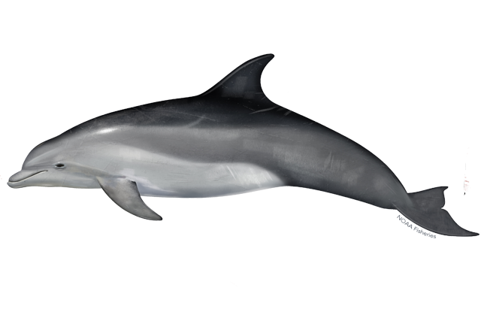
Practice problem: Which terms apply?
prokaryote
eukaryote
plankton
nekton
benthos
pelagic
benthic
autotroph
heterotroph
photoautotroph
chemoautotroph
phytoplankton
zooplankton
bacterioplankton
Image: NOAA
Notes:
Here we have all of the terms in a list. See if oy can figure out which terms apply to this particular marine organism.

Slide 42
Practice problem: Which terms apply?
prokaryote
eukaryote
plankton
nekton
benthos
pelagic
benthic
autotroph
heterotroph
photoautotroph
chemoautotroph
phytoplankton
zooplankton
bacterioplankton
Image: NOAA
Notes:
This is a dolphin, which is an animal. We know that it is a eukaryote, because it is multi-celled and only eukaryotes can be multi-celled. We know that is swims strongly, so it is also a member of the nekton. It spends its life swimming around, so therefore is pelagic. It is heterotrophic—we know this because it is an animal and all animals are heterotrophic, even if we haven’t watched videos of dolphins eating fish.

Slide 43
Practice problem: What is the source of energy for these fish and coral animals?
Photo: Joe Hoyt, NOAA, in the public domain
Notes:
Here is the coral reef picture that we discussed at the beginning of the class. Hopefully now we are better able to imagine how these organisms are living in the marine environment, and what their relationships with each other might be. Pause the video if you would like to think about the question. (Pause.) Both the fish and the corals are animals, which means that they are multi-celled heterotrophs. They are dependent on the autotrophs for food. Obviously with this much life, there must be a lot of photosynthesis going on. But we don’t see any plants. So the primary productivity in this community is the phytoplankton, which are not visible in the picture. Although interestingly, many coral animals house single celled photosynthetic organisms within their tissues which also contribute to the primary productivity of coral reefs.

Slide 44
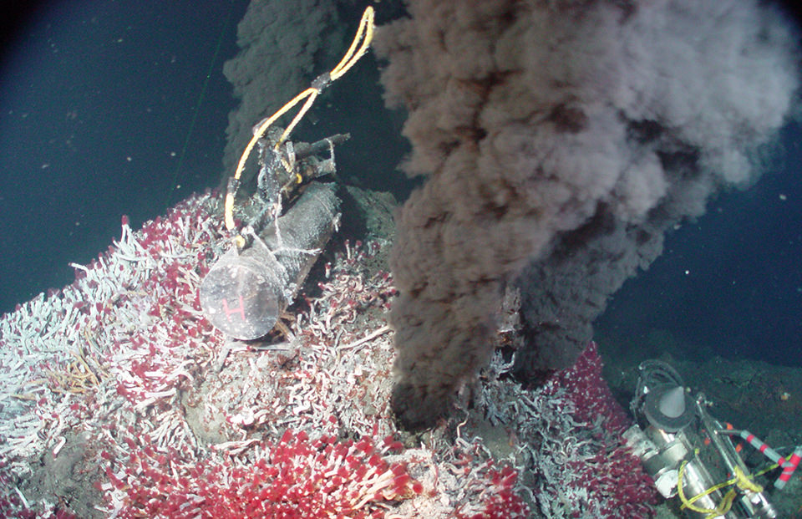
Practice problem: How is this community structured differently than the one in the previous picture?
Photo: NOAA, in the public domain
Notes:
Here’s another very different-looking community. This community doesn’t include corals, but there is still a lot of life here, including fish, not shown. So what’s fundamentally different here in how the community is structured? Pause the video if you’d like to think. (Pause.) Our clue here is the “black smoker” hydrothermal vent. This is a feature we would find at a mid-ocean ridge, far, far below the depth to which sunlight can penetrate. So photosynthesis is impossible here, but we still have a thriving community. Primary productivity in this community is chemosynthesis rather than photosynthesis.

Slide 45
In-class activity: Mystery Marine Organisms!
In this activity I will describe a marine organism, and based on the description, you will determine which terms apply.
Identifying the organism is optional! ☺
Notes:
In class we are going to play a game, where you will read a description of an organism and you will figure which of all the terms we just learned apply to that organism. You don’t have to figure out what they are, but it’s more fun if you do!

